Slide 1


Creating the Chicago Collections Consortium
Ellen Keith, Executive Director
ekeith@chicagocollections.org

Slide 2
The Chicago Collections Consortium
WHO WE ARE
Launched in 2012, the Chicago Collections Consortium is a membership organization composed of not-for-profit institutions with collections that chronicle the rich history of Chicago. The work of this collaboration is led by a Board of Directors drawn from the participating institutions. Their work is accomplished with guidance from several standing and advisory committees.

Slide 3
A Shared Commitment
Mission
Chicago Collections is a collaboration among libraries, museums, and allied organizations working together to collect, preserve, and share freely, openly, and equitably the history and culture of Chicago with the world.
Vision
Chicago Collections envisions a world where the history of Chicago is made accessible to diverse communities to foster understanding, inspiration, and knowledge creation through engagement with primary sources.

Slide 4
A Shared Commitment:
Making Chicago’s Primary Sources Discoverable
CCC had its genesis in this discussion from the founders
How to ensure the care and preservation of Chicago-related primary sources across collections
How to make those materials more visible to scholars and the public
Source: Case, M. M., & Spadafora, D. (2021). A Decade of Collaborating, Preserving, and Sharing: The Chicago Collections Consortium. portal: Libraries and the Academy, 21(4), 655-664. DOI: 10.1353/pla.2021.0035

Slide 5
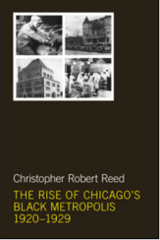


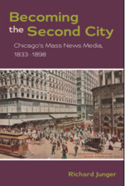
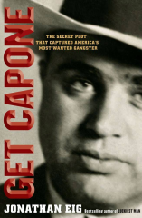
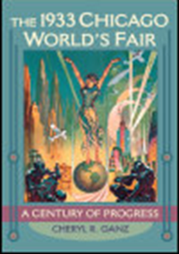
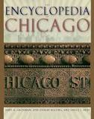
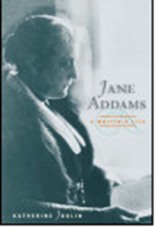
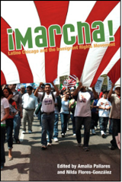
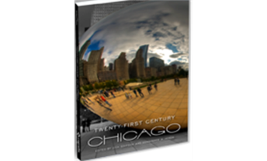
A Shared Commitment:
Facilitating Scholarship

Slide 6
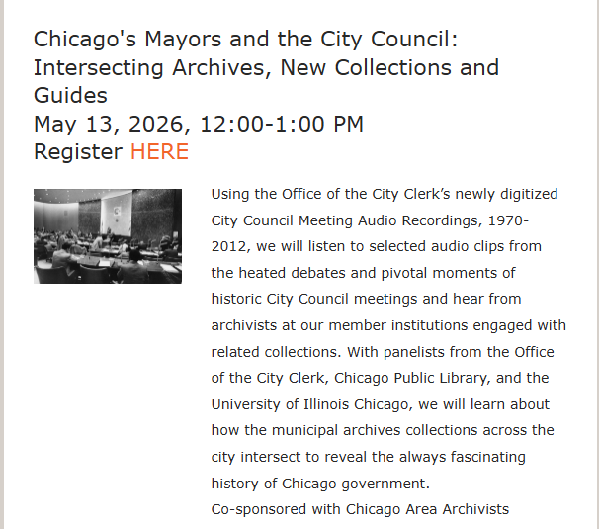
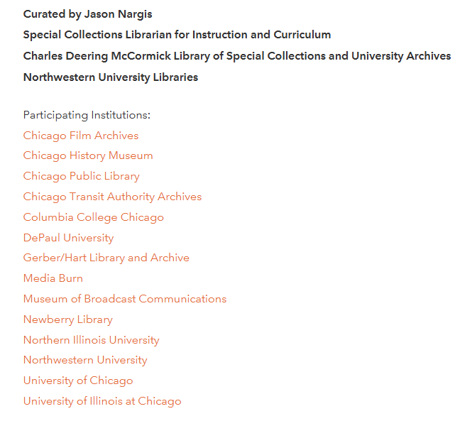

A Shared Commitment:
Collaboration and Community

Slide 7











Governing Members
Notes:
Governing Members listed include the original founding members - CCC governing members are institutions with significant collections relevant to the Chicago region and have voting rights.

Slide 8





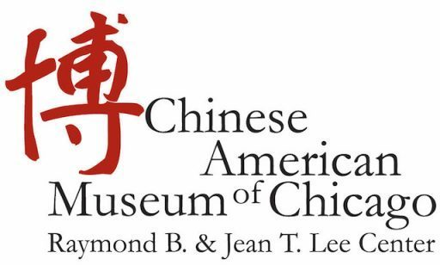






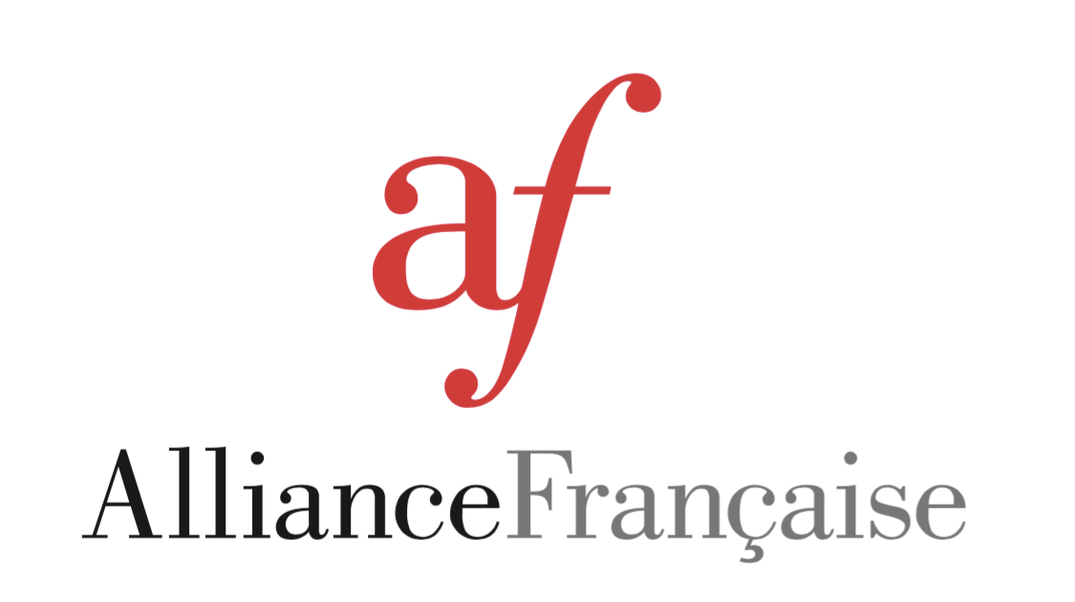
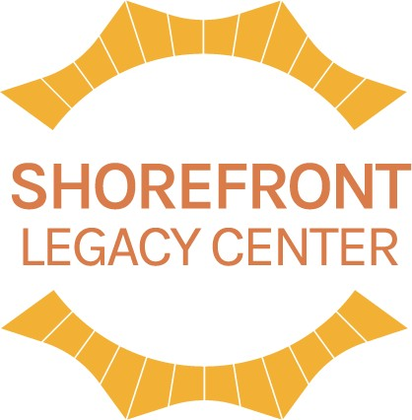







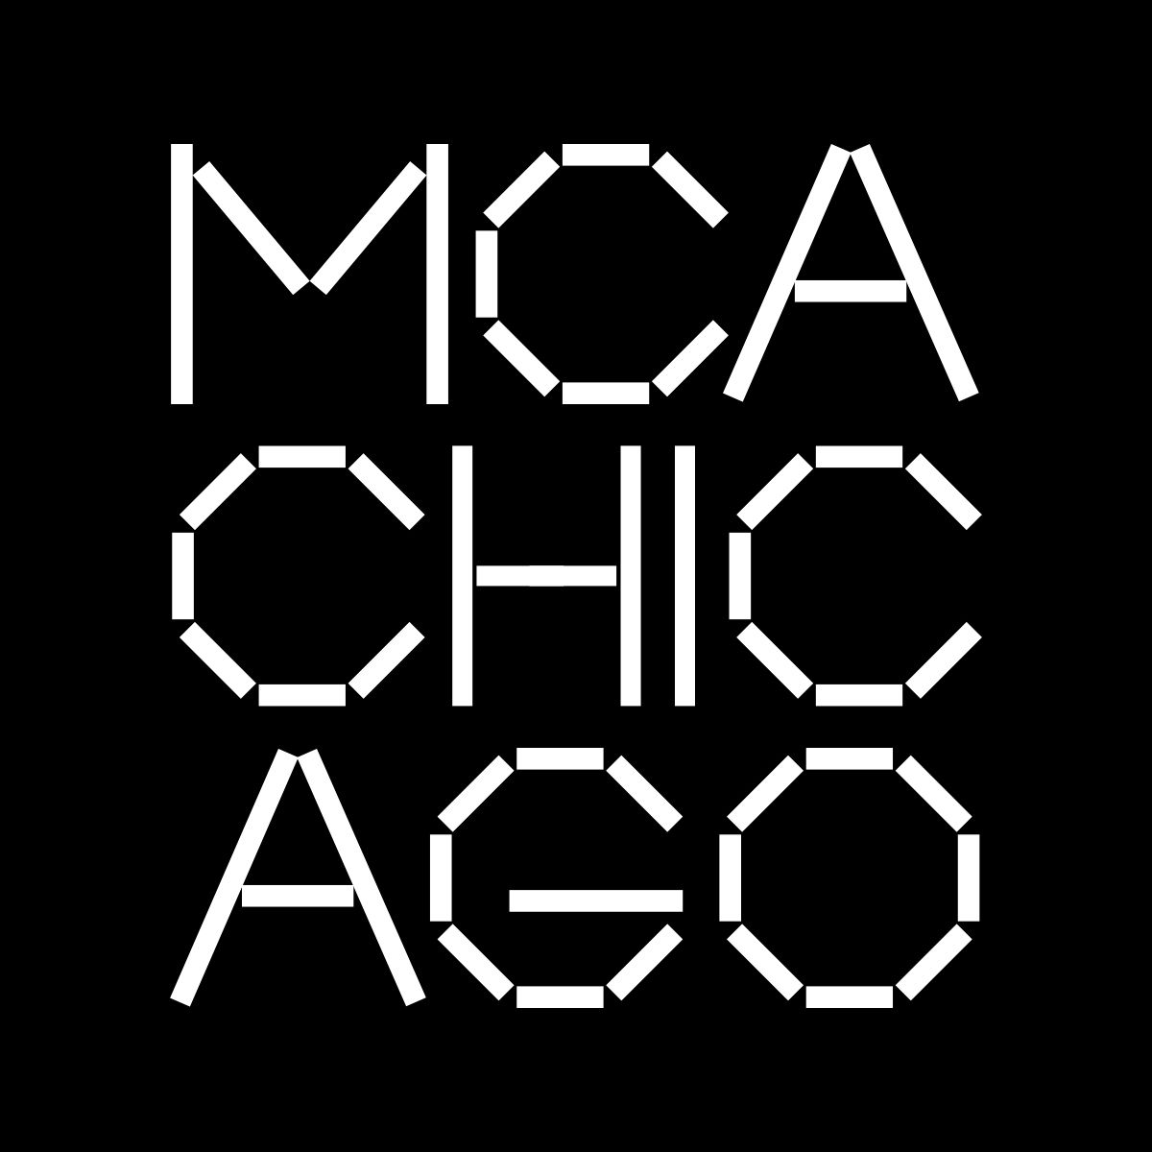








Members
Northwestern Memorial HealthCare Archives
Notes:
With over 60 member organizations whose are relevant to Chicago’s history and culture and range from art museums to planetariums.

Slide 9


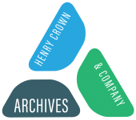

Corporate Partners

Slide 10








Generous Supporters
We are also supported by many individual donors.

Slide 11
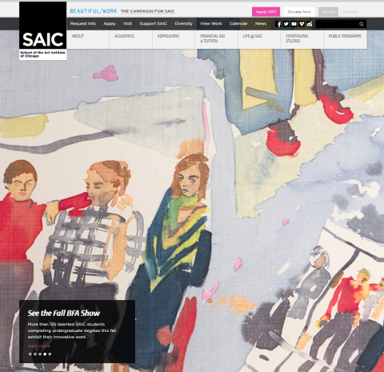
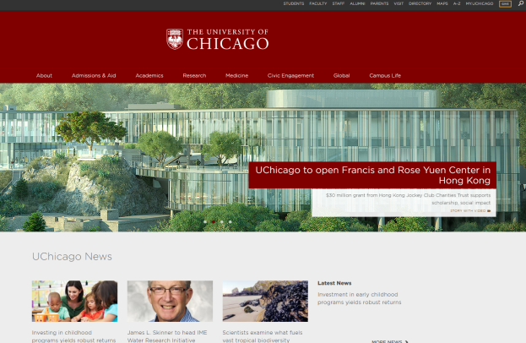
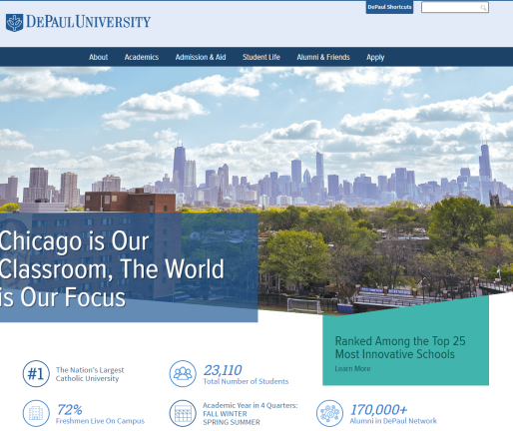
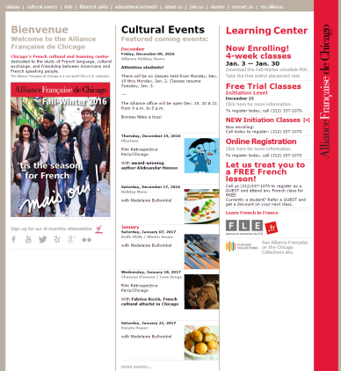
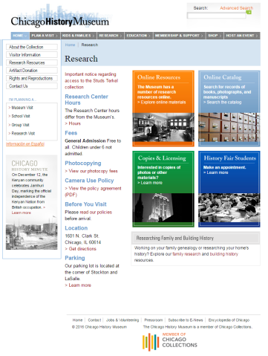
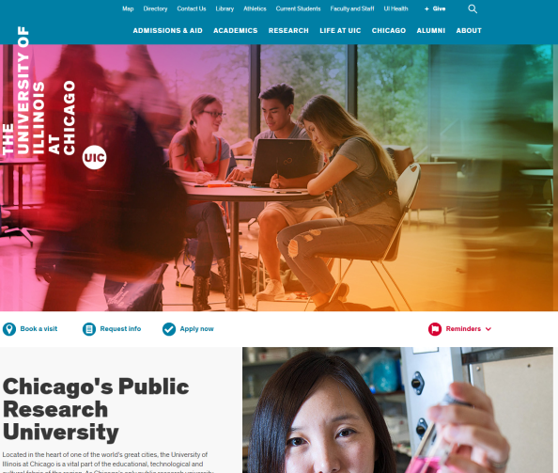
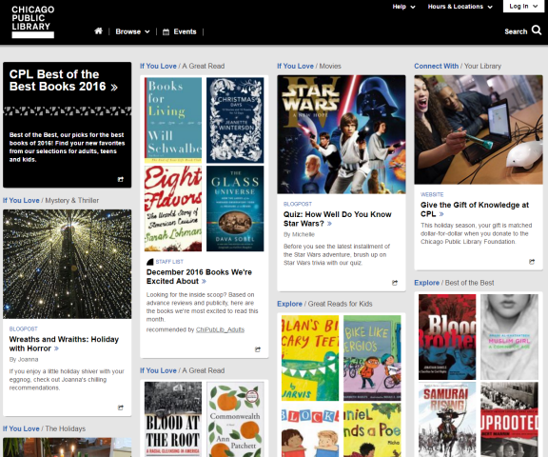
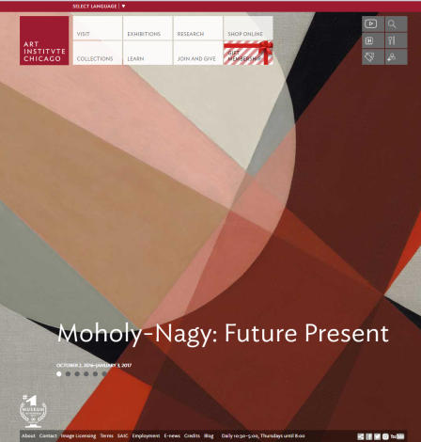
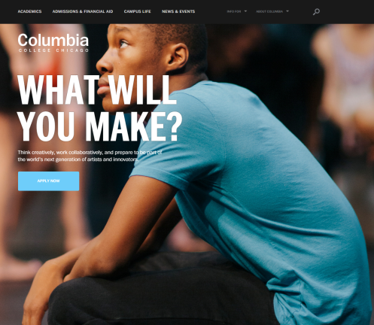
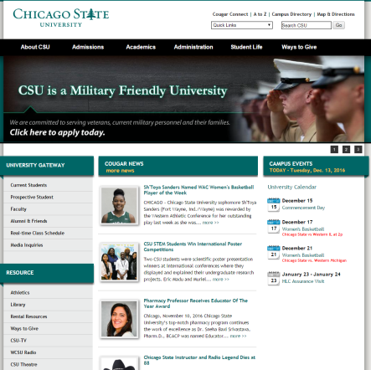
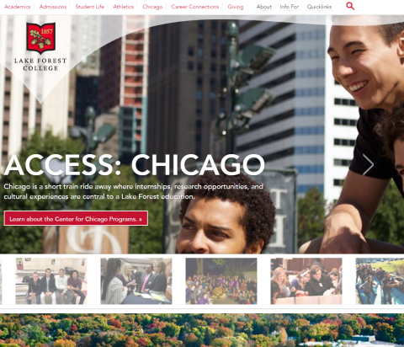
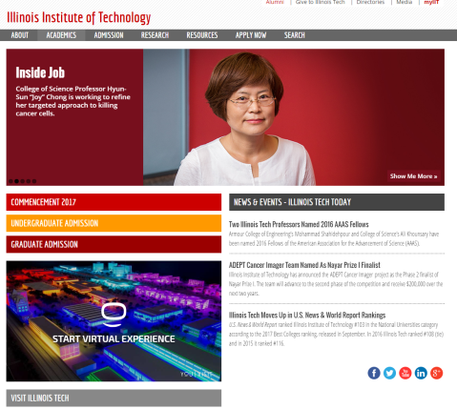
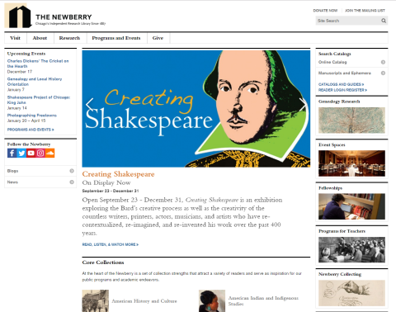
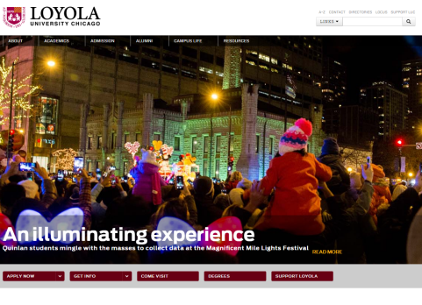
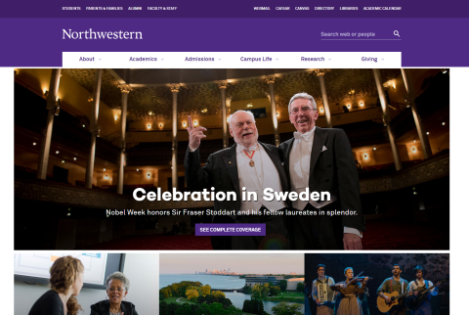

Before EXPLORE….
Notes:
Previously, users would have to visit 19 different institutional sites. (all of these are screenshots of institutional sites – the assumption that users would be starting from the very beginning)

Slide 12
The backend to EXPLORE: Metadata Hopper
Design Principles
The Chicago Collections Portal Committee established the following principles to guide the implementation of this project:
  The system will provide full access to finding aids in their entirety, rather than simply accepting brief descriptions of collections. This enables researchers to find even obscure connections between related collections from different institutions.
  The system uses a 'deposit' rather than a 'harvest' approach to contributing content; member institutions must not be required to maintain any additional local infrastructure in order to participate.
  The system will not require any institution to change its local metadata practices or to maintain a second copy of materials that Explore Chicago Collections can accept.
  The system will accept both the direct deposit of image media files or the deposit of metadata files that point to an image media file.
  The system must be able to expand to support new types of media and metadata.

Slide 13
What is Metadata Hopper?
Metadata Hopper is a tool designed to with the eXtensible text framework (XTF) from California Digital Library
XTF allows for creation of simple Dublin Core files to be used alongside your original metadata for searching and browsing
Metadata Hopper creates these Dublin Core file using your original metadata

Slide 14
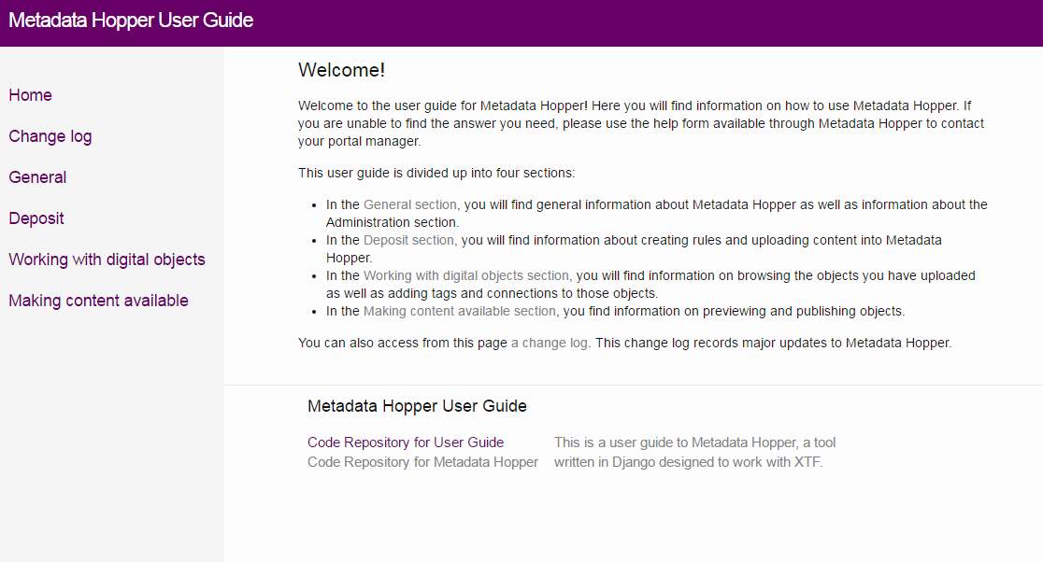
https://metadatahopper.bitbucket.io/

Slide 15
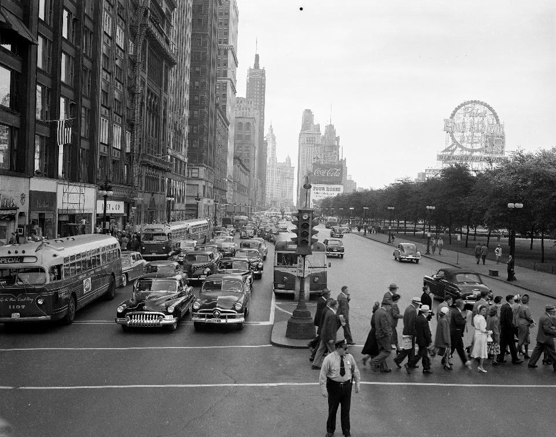

An online portal to discover
the history and culture of Chicago
Michigan & Monroe, early 1950s. IDOT Chicago Traffic Photographs, University of Illinois at Chicago

Slide 16
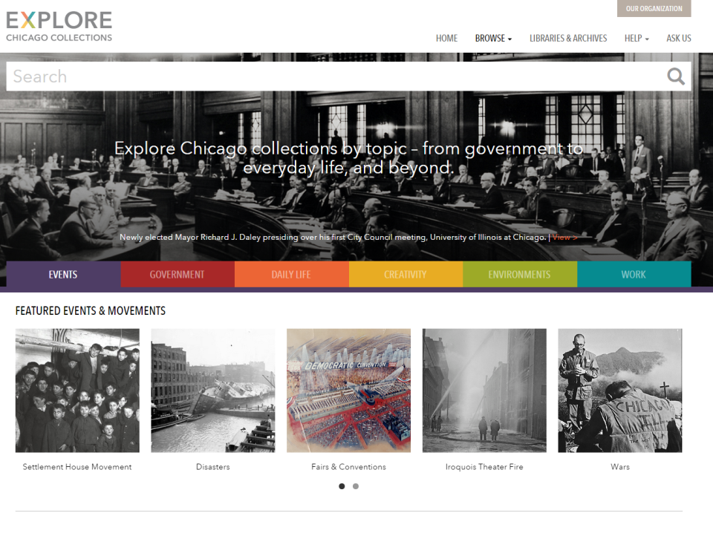
EXPLORE TOPICS – EVENTS, MOVEMENTS,
BUILDINGS, DISASTERS
Notes:
The over 13,000 subject terms in the original metadata have been distilled down to 88 topical terms under 6 main categories. 87 of those connect you to more than one library. 57 of them connect you to 6 or more libraries.

Slide 17
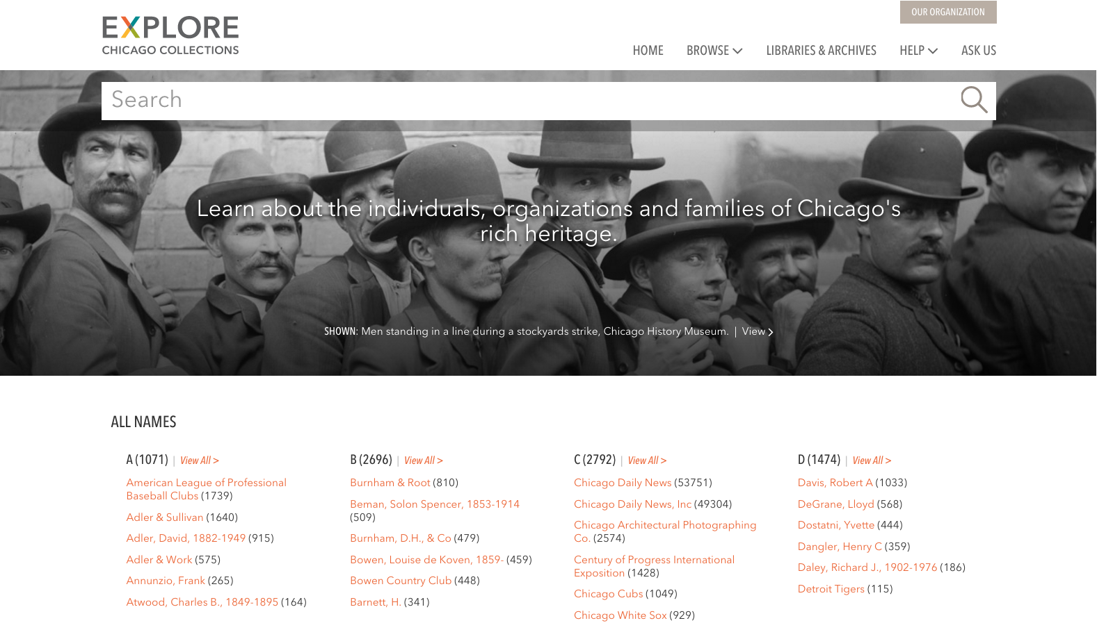
EXPLORE PEOPLE AND ORGANIZATIONS
Notes:
Incoming names are also mapped to an authority list for browse access.

Slide 18
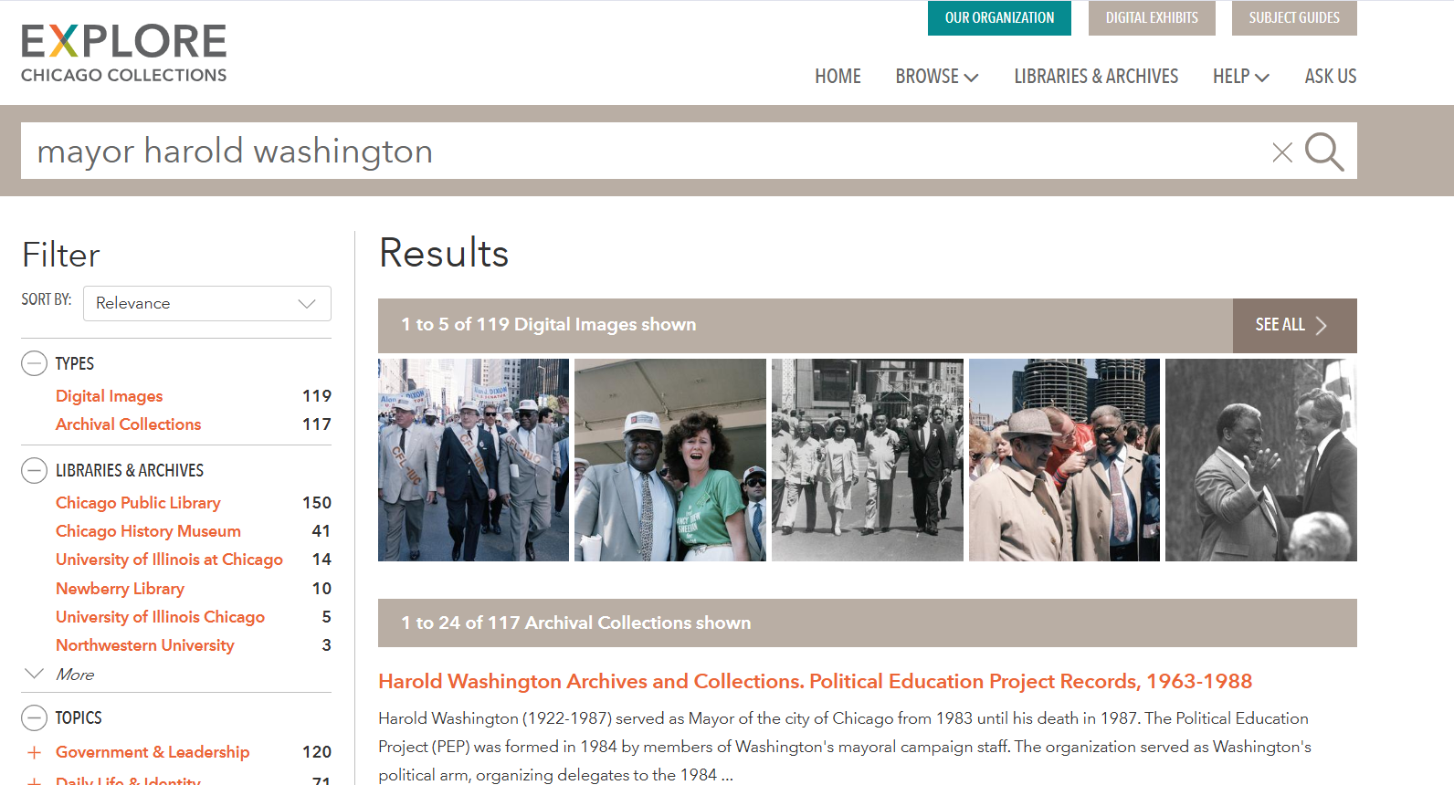
SEARCH METADATA RECORDS
Notes:
A full text search will find the term anywhere in the either the original metadata or the new metadata applied to ECC records.

Slide 19
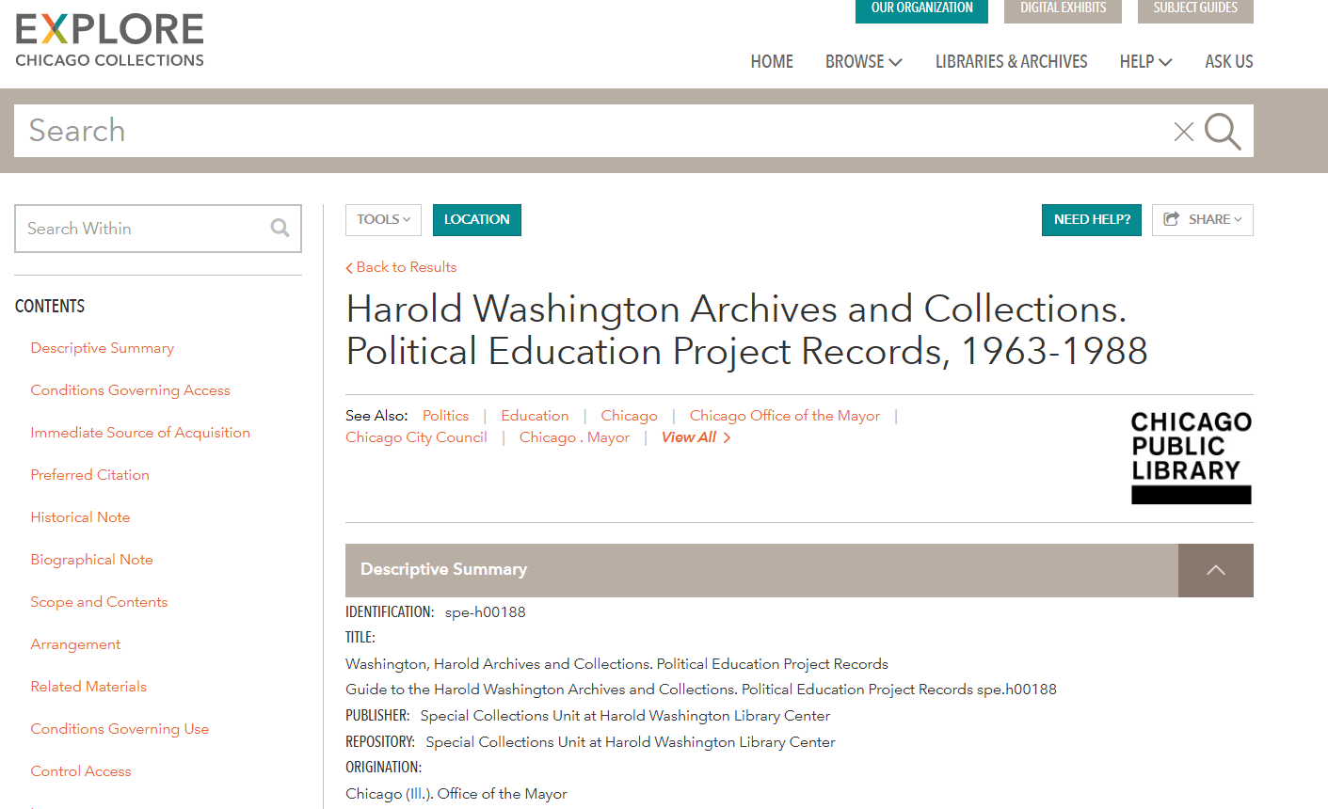

Slide 20
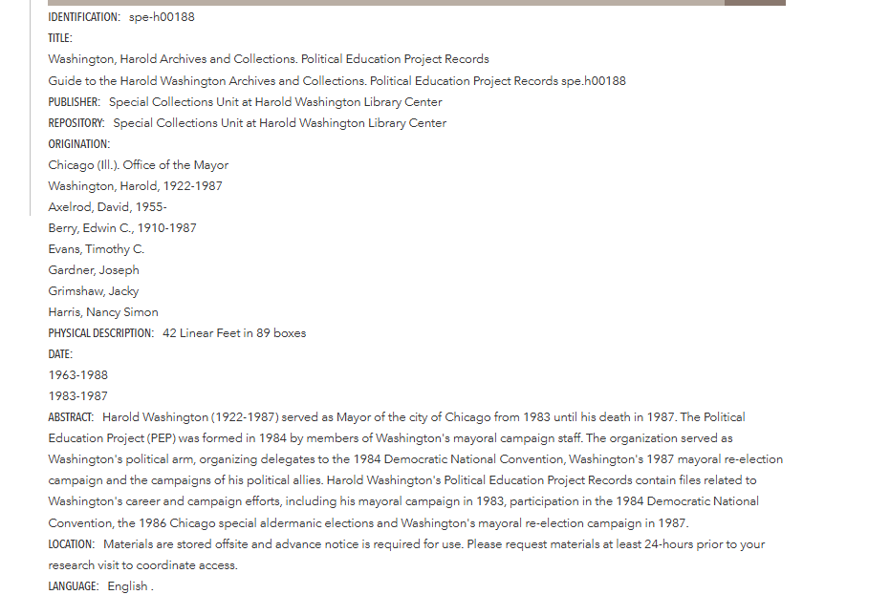

Slide 21
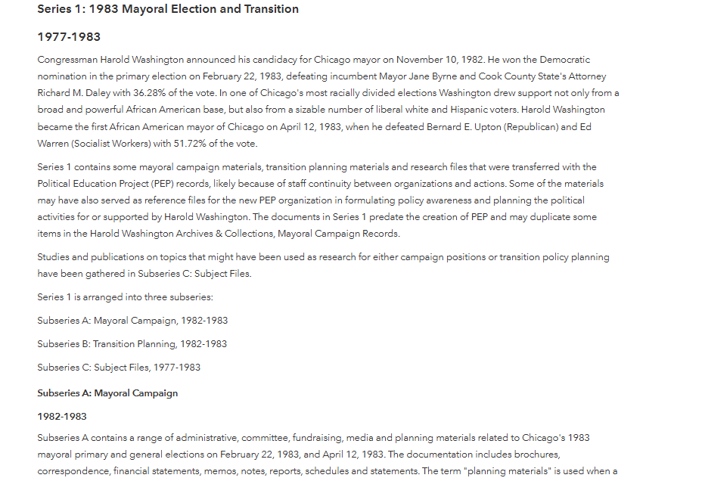

Slide 22
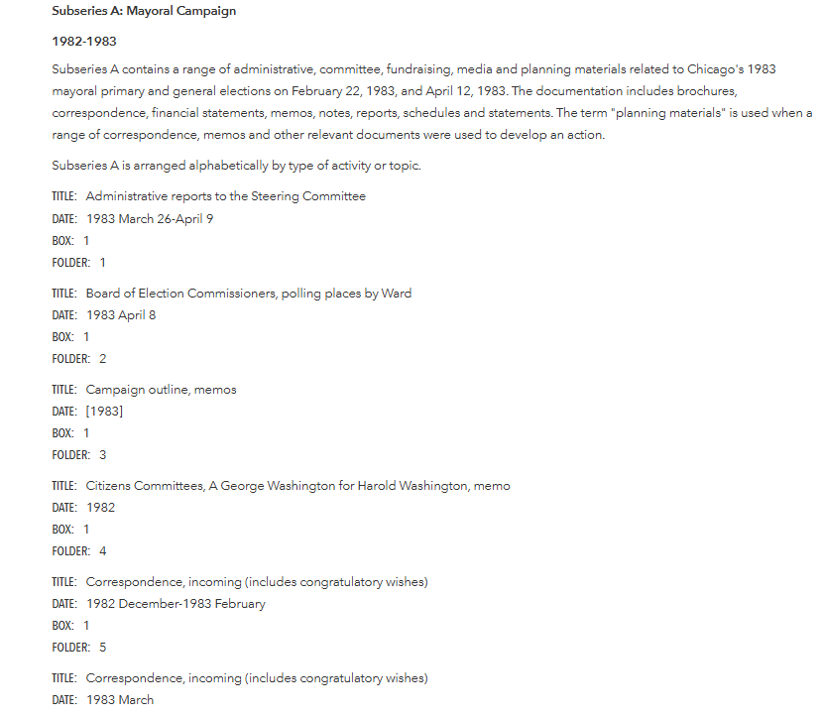

Slide 23
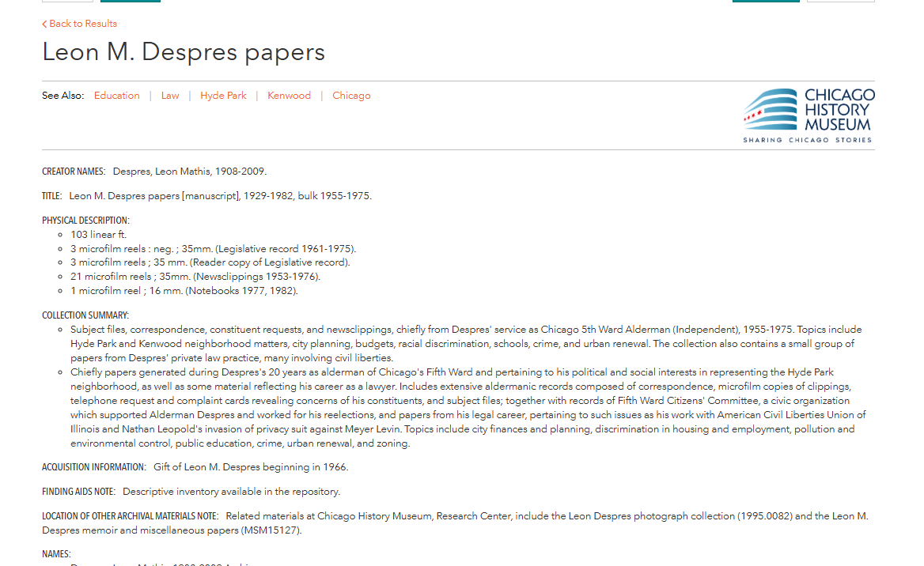

Slide 24
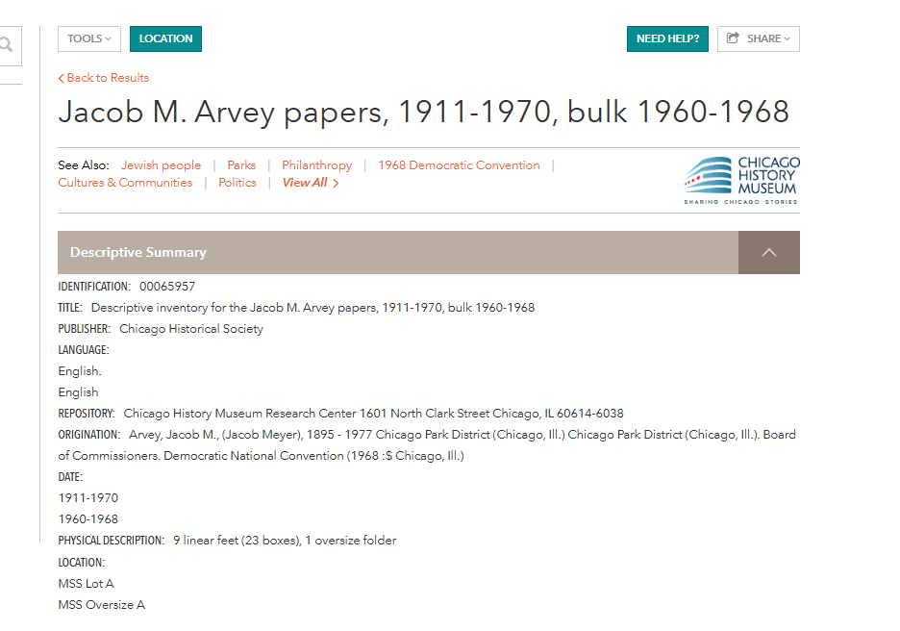

Slide 25
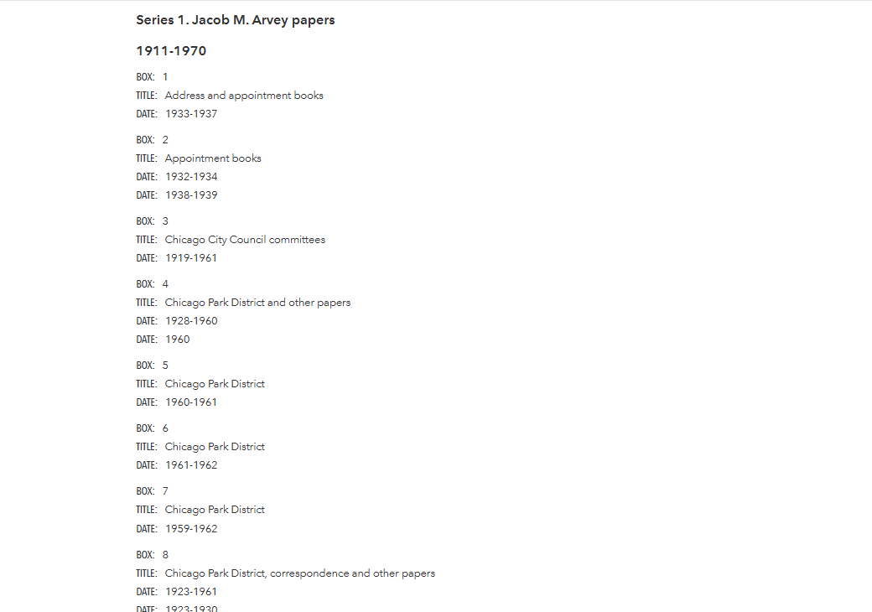

Slide 26
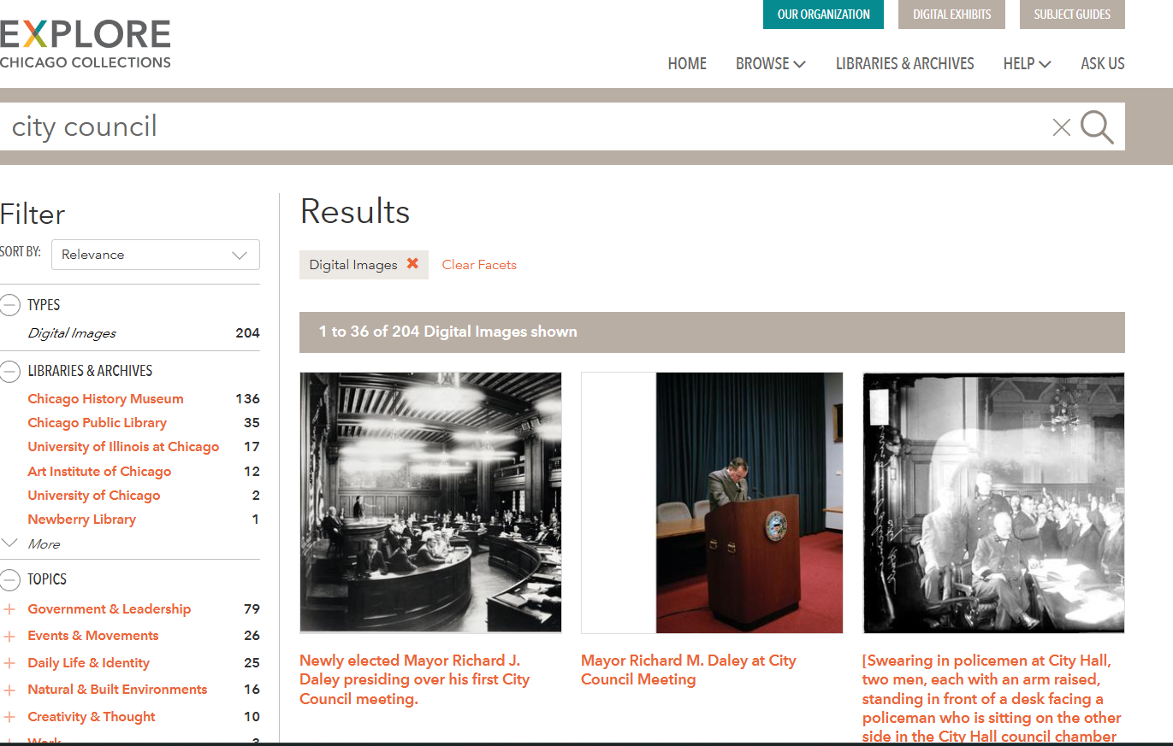
SEARCH OVER 100,000 IMAGES
Notes:
Search over 100,000 images

Slide 27
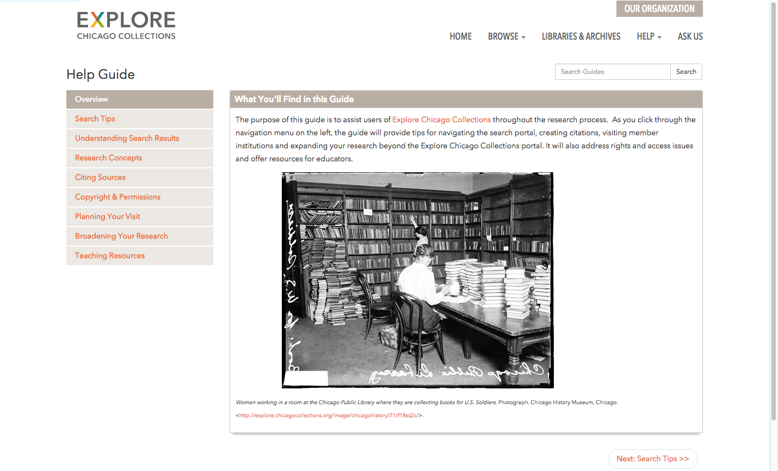
ASK FOR HELP
Notes:
In addition to providing information on how to use the EXPLORE portal - the site also provides information on member collections and accessing their collections in person if necessary.

Slide 28


2026-2027
What’s Coming
Upgrades Coming Soon
Notes:
We would be remiss to not include that we are still actively working on upgrades to our flagship project, EXPLORE Chicago Collections. We have spent the last year engaging in the Define and Design Phase of our EXPLORE upgrade with the Americaneagle digital marketing firm to identify pathways forward that would ensure stability, security, and support for digital collections access.
The Systems Development and Analysis Committee has been essential in this process, coming to the conclusion that we must migrate from our current XTF based system to an archival management system. In 2025 the selection of the Islandora platform was made after an extensive review of the platform by the Systems Development and Analysis Committee. Beginning in 2026 Ellen and Jessica representing CCC have had weekly meetings between the Americaneagle team project managers, Drupal specialist to determine the Design of the new EXPLORE access layer. Conversations have also begun on implementing the replacement of MetadataHopper, through the Islandora platform.

Slide 29
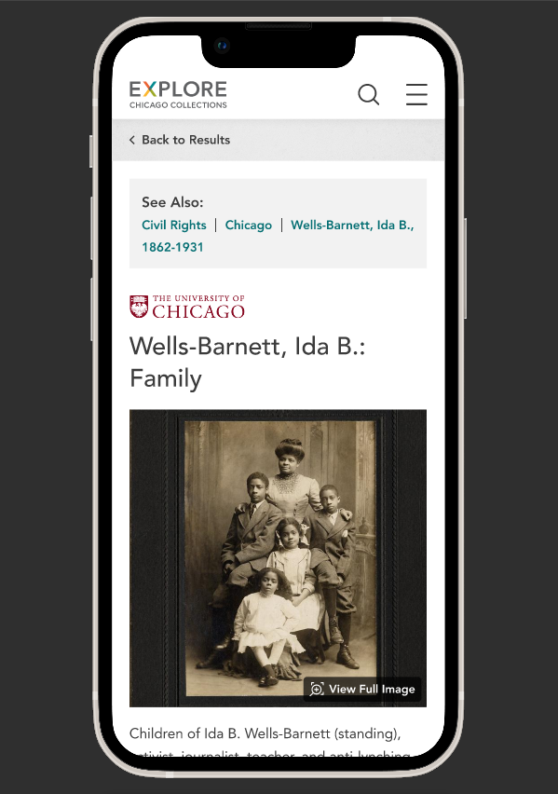
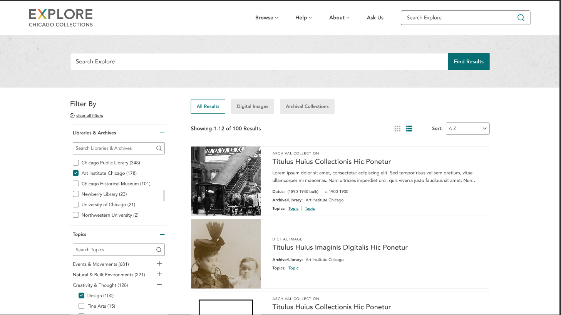
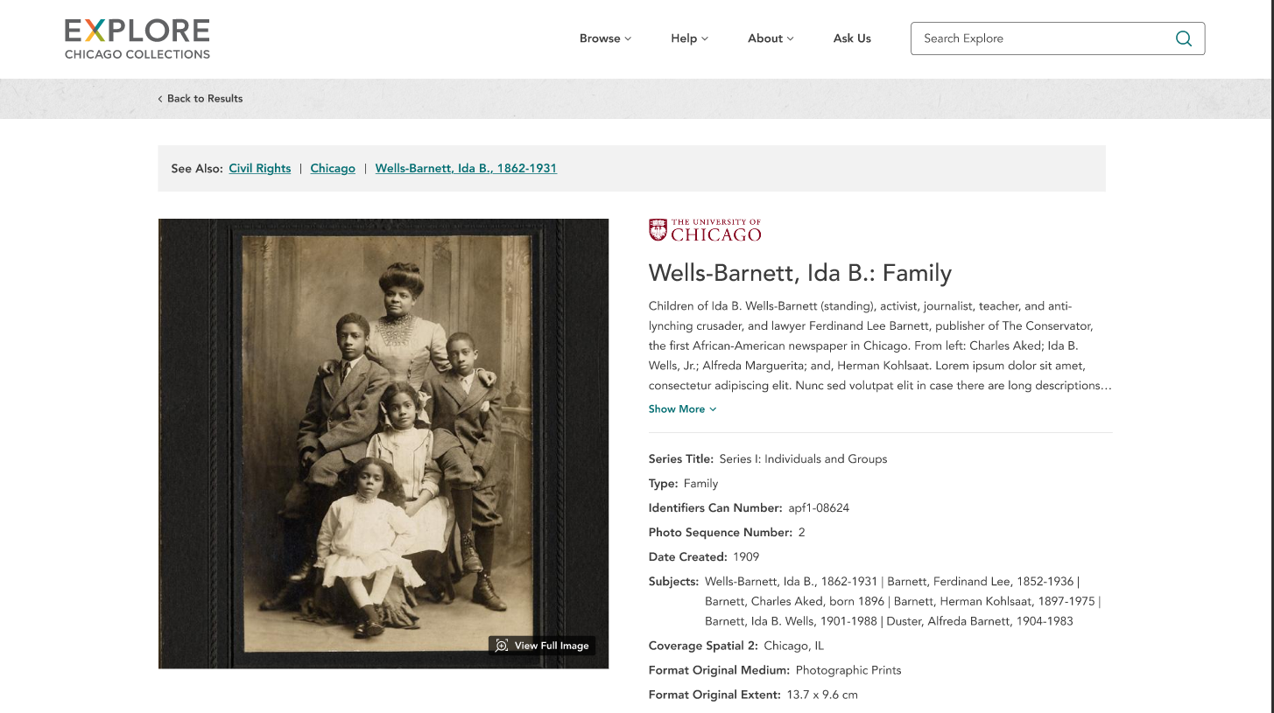
2026-2027
What’s Coming
Notes:
Designs created by the AmericanEagle team include both the desktop view, but also now a mobile version. This is critical as 20% of EXPLORE users are accessing via a mobile device. These designs have been shared with Systems Development and Analysis Committee, Digital Resources and Collections Committee, and the Board. The designs were included in a grant to the National Endowment for the Humanities, submitted in May 2026. CCC has applied under the Collections Stewardship Grant program for 320,000 dollars to go towards the build of the new EXPLORE site, the build of the new Islandora preservation layer to replace MeatadataHopper, and towards the migration of assets out of MetadataHopper and in to Islandora.

Slide 30
Building on the Foundation:
Cooperative Reference Network
  ASK@Chicago Collections http://ask.chicagocollections.org/
  A Virtual Reference Desk
  Integrate with the Portal
  Development of Instructional Materials
Notes:
Cooperation among librarians at member institutions to answer questions - literally a virtual reference desk across the city allowing further discoveries of unique collections.

Slide 31

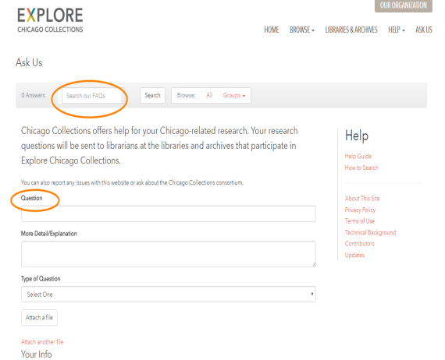






Reference Referral Network
Notes:
We have a question form on the website. Questions are answered by a handful of Librarians & archivists from our member institutions.

Slide 32
Reference Referral Network
Collection
Specific
Genealogy
Digital Image Use
Donations & Appraisals
Notes:
Types of questions we receive…

Slide 33
Reference Referral Network
How can I find information on a building my grandfather owned in the 1940s on Halsted Street. It was a grocery store. The address was 903 S. Halsted.
2 paths to investigate: Bricks & mortar (the architectural style, the architect, the contractors, alterations) & People (owners/dwellers)
The archivist provided a link to a blog on researching a small businesses and to a publication from the city's landmarks commission on researching the history of a building.
She also suggested searching the Chicago Tribune database for references to real estate transactions, people, or advertisements related to the business/building and recommended looking at city directories and Chicago building permits (Chicago History Museum).
Notes:
This one is typical of family-related inquiries that come through the site…

Slide 34
Share us with Friends on Social Media
Bluesky@chicollections.bsky.social‬
Join our eNews from our Homepage @
chicagocollections.org
Explore collections @
explore.chicagocollections.org
Facebook
@ facebook.com/ChiCollections
Instagram
@instagram.com/chicagocollectionsconsortium

Slide 35
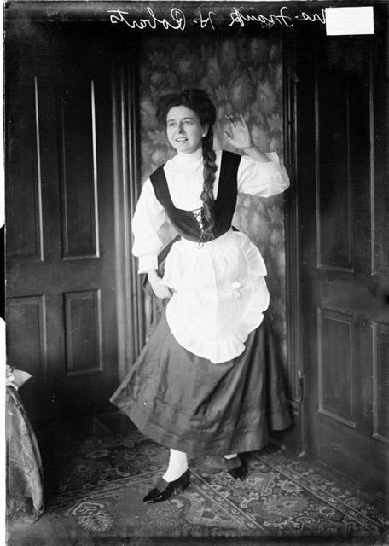
Questions?
Chicago Daily News, Inc., photographer. [Mrs. Frank H. Roberts, wearing a costume, standing with one hand holding her skirt and the other hand raised],1927, The Chicago History Museum, DN-0089960

